Slide 1
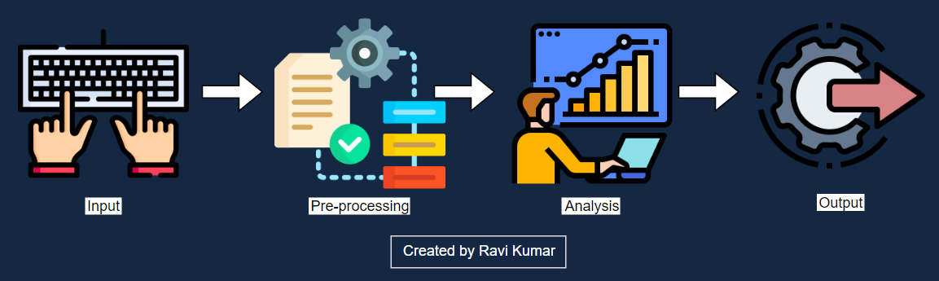

Advanced Data Tagging For Data Fitness and Quality
THE GOLDEN HAWKS

Slide 2






TEAM
Nancy Antony SCRUM MASTER
Nashid Kouser PRODUCT OWNER
Srisuda Kittisupakorn DEVELOPER
Vikas Gunnam DEVELOPER
Harshik Nadipalli DEVELOPER
Saiteja Pulluri DEVELOPER

Slide 3





MITRE - UNIVERSITY INNOVATION EXCHANGE PROGRAM
MISSION
Automating data tagging
FOCUS
DOMAIN
Cross functional domains
Data Fitness in terms of quality and relevance
d
PROJECT GOALS
PARTNERS
Streamline Data Tagging for both Text and Image Datasets
d
Dr. Randy Howard
Nick Pesce
Chris Basel
Brianna Salameh

Slide 4

AGENDA
01
Problem Space & Data Fitness
02
Datasets Exploration Transformation & Data Analysis
03
Algorithms, Modeling & Visualizations
04
Results, Findings & Next Steps

Slide 5
Problem Space and Data Fitness
1

Slide 6
PROBLEM SPACE
Problem Statement
Proposed Solutions
Manual tagging of metadata.
Quality and Relevance are not typically combined to assess fitness.
Business questions and tasks are not considered for determining data fitness.
Reduce the manual-intensive work in DLM process by advance data tagging.
Establish Business Question mapping.
Topic Modeling & BERT Model.
Generate Data Tags, Indicators, Measures Appropriate to Indicate fitness
Business Benefit
Empowers businesses to make informed decisions while choosing data that best fit their needs

Slide 7
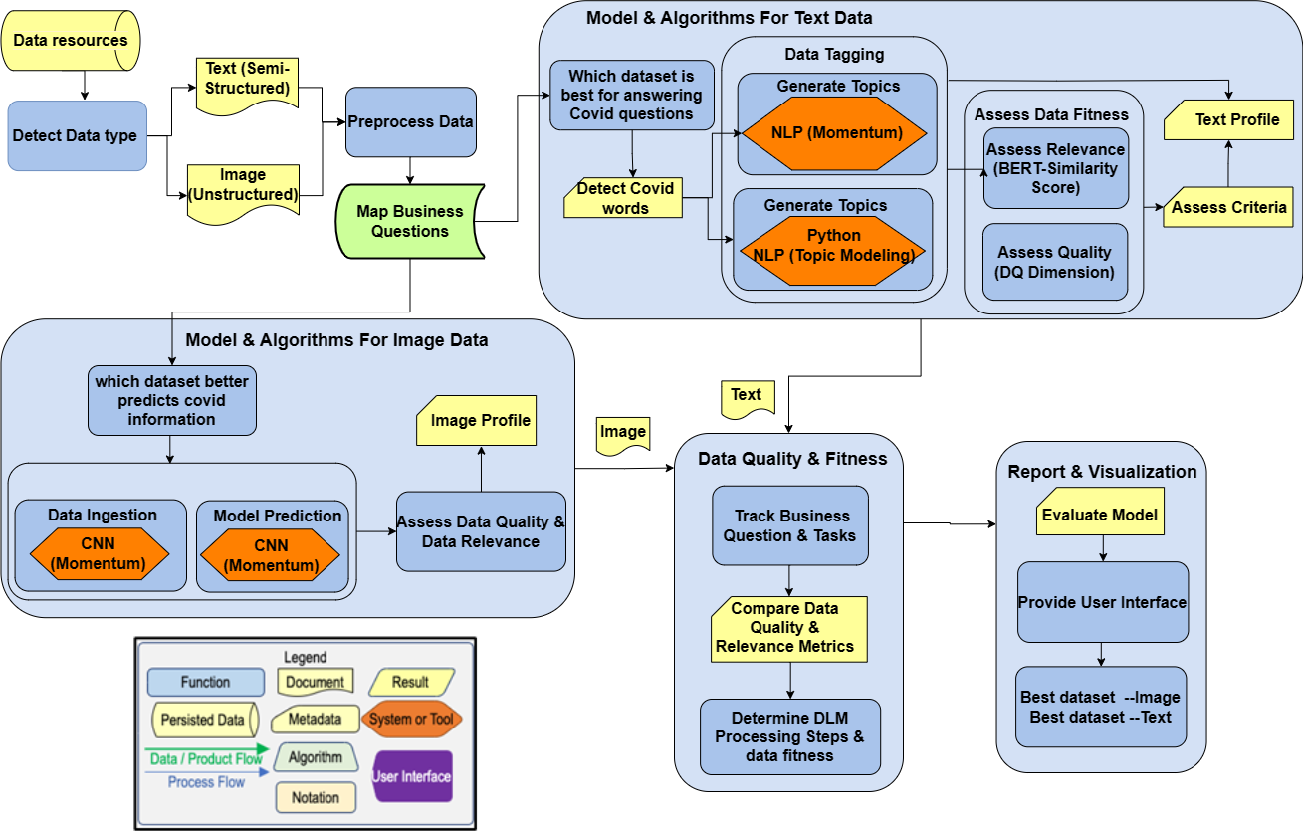
SCHEMATIC FLOW

Slide 8
DATA FITNESS
Data Quality Dimensions
Relevance
Duplicated data
ACCURACY
UNIQUENESS
CONSISTENCY
COMPLETENESS
RELEVANCE
Missing data Misspelling Ambiguous data Incorrect data
Ambiguous data Incorrect data Wrong data type Special characters
SERVICES
Duplicated data
Missing data Incorrect data
Similarity
Mercury is the closest planet and also is the smallest one of the Solar System

Slide 9
Datasets Exploration and Transformation
2

Slide 10
DATASETS
Mitre Synthetic Health data
Tweets
Semi-structured data(CSV)
1 MB
4 Million Text Entries.
Structured data (CSV)
7 GB
Contains 3,332,799 observations.
Covid 19 Image
Unstructured data(Image )
166 MB
317 Images.
BBC
Semi-structured data(CSV).
1 MB
5 attributes and 14763 observations.
Covid CXR
Unstructured data(Image)
600 MB
1823 CXR Images.
10

Slide 11
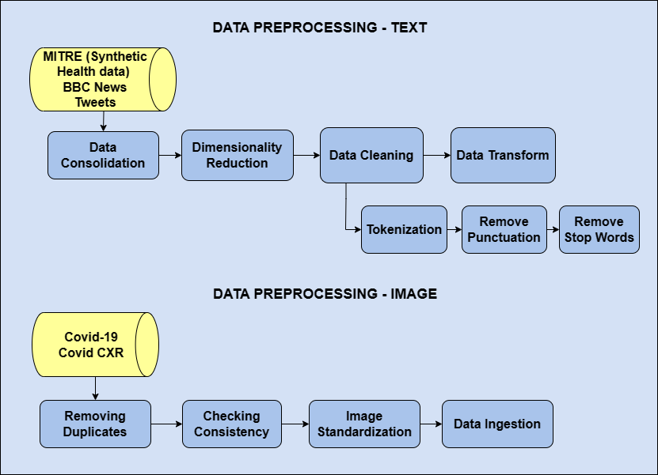
DATA PREPROCESSING

Slide 12
DATA ANALYSIS
TEXT DATASETS
IMAGE DATASETS
Descriptive Texts to detect Covid keywords.
Analyzed Chest X-ray Images.
Columns include ‘Description’ and ‘Summary’.
For detecting Covid impacted X-rays.

Slide 13
Algorithms, Modeling and Visualizations
3

Slide 14
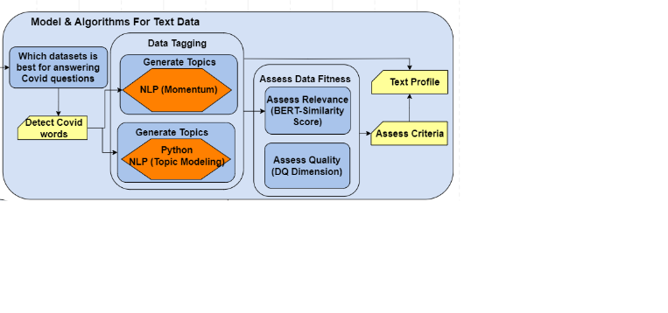


TOPIC MODELING-LATENT DIRICHLET ALLOCATION
K-Topics
Cluster of Words
Topic Modeling is used to analyze big unlabeled text data by grouping them into topics.
LDA is a probabilistic statistical model.
The Coherence Score measures how well words in a topic related to one another.
A high coherence score indicates the topics are relevant to each other.
LDA
Frequency of Words
Topic
Documents
LDA Model Output
Distribution of Topics

Slide 15
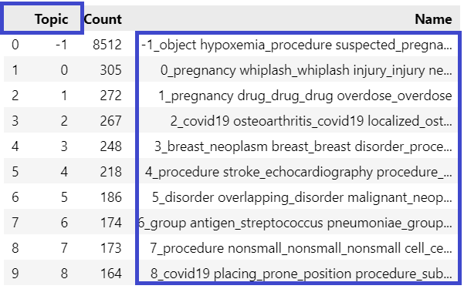
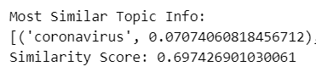
BIDIRECTIONAL ENCODER REPRESENTATIONS FROM TRANSFORMERS (BERT) MODEL-SIMILARITY SCORE
BERT is trained on massive data corpus.
Identify the context of the sentence using Transformers.
It measures the semantic similarity between sentences.
Semantic similarity refers to the task that compares the similarity between one text to another.
Calculated sentence similarity score.
Used BERTopic library for calculating topic similarity.
Extracted covid keywords like Covid, Symptoms, Prevention and Treatment.

Slide 16
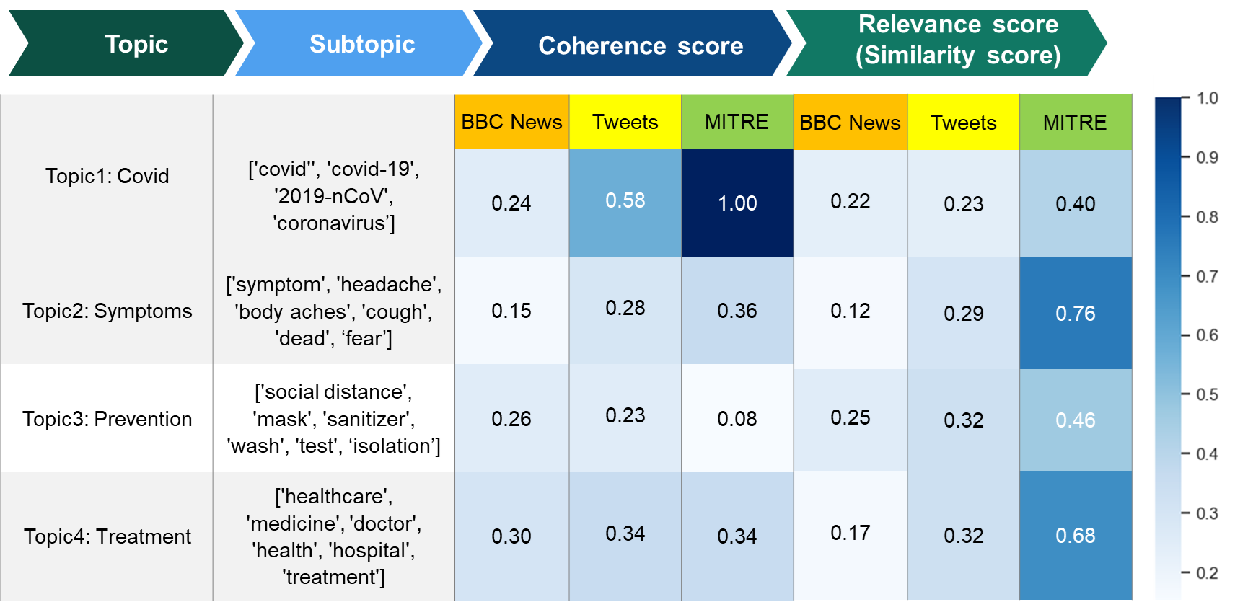
Which dataset best answers covid questions?
TEXT DATASETS RESULTS
Important takeaway is that users receive more detail results from Topic and Sub-topic about Business Question.

Slide 17
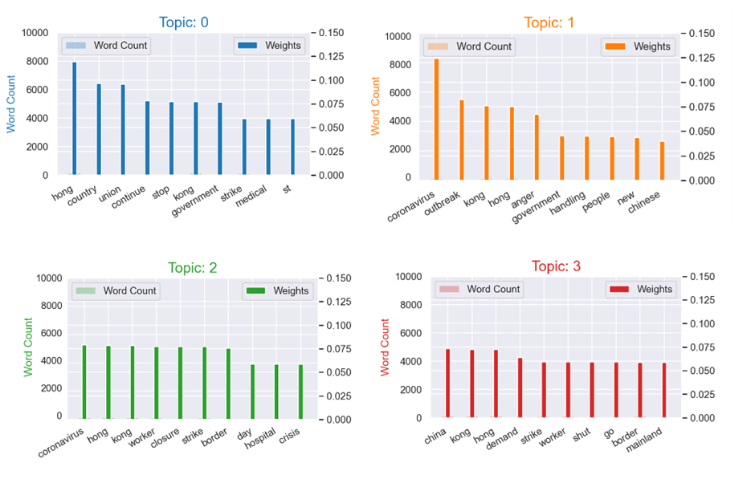
WORD COUNTS OF TOPICS

Slide 18
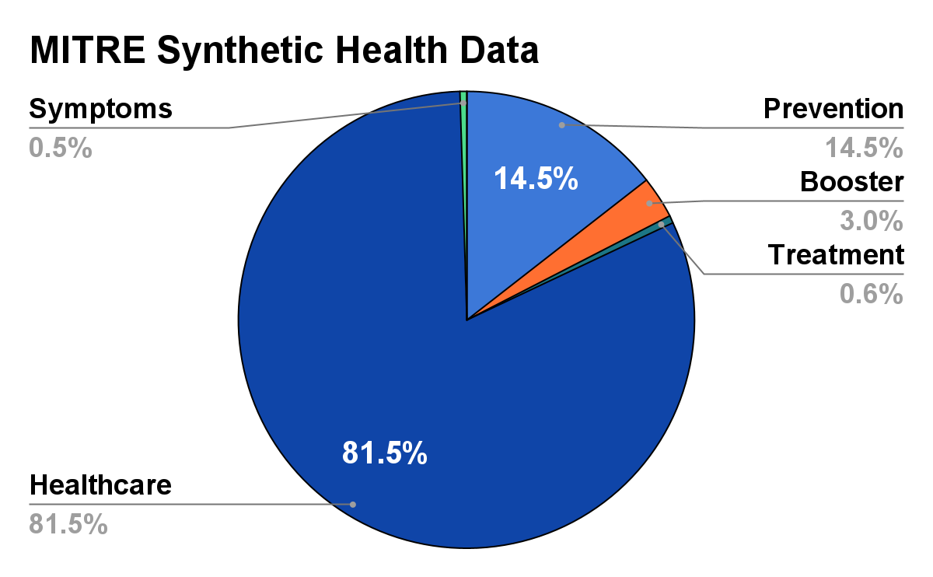
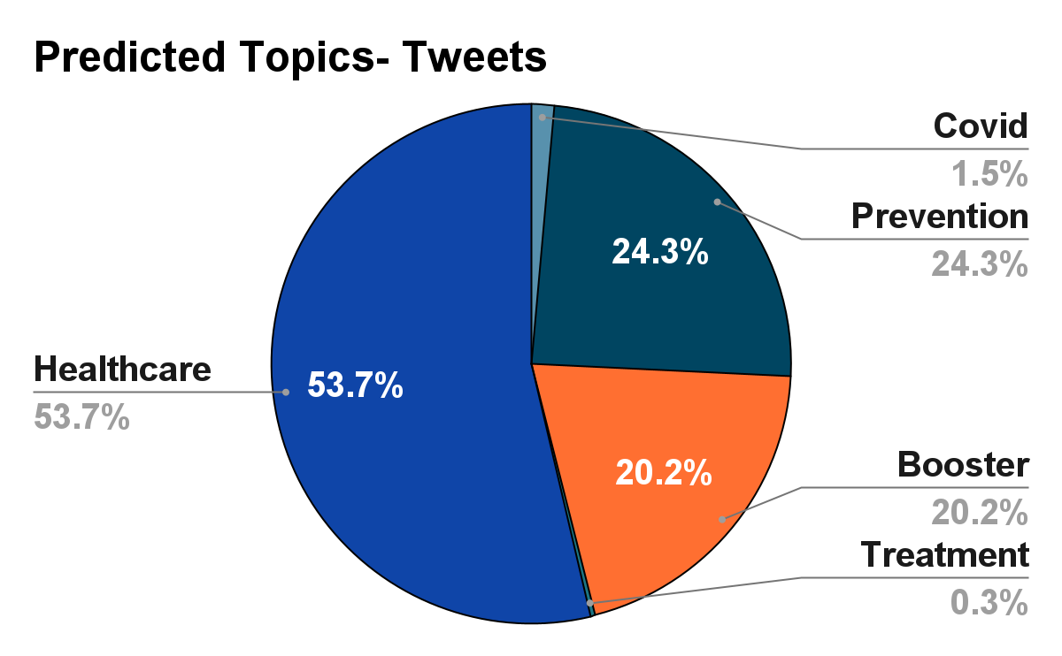
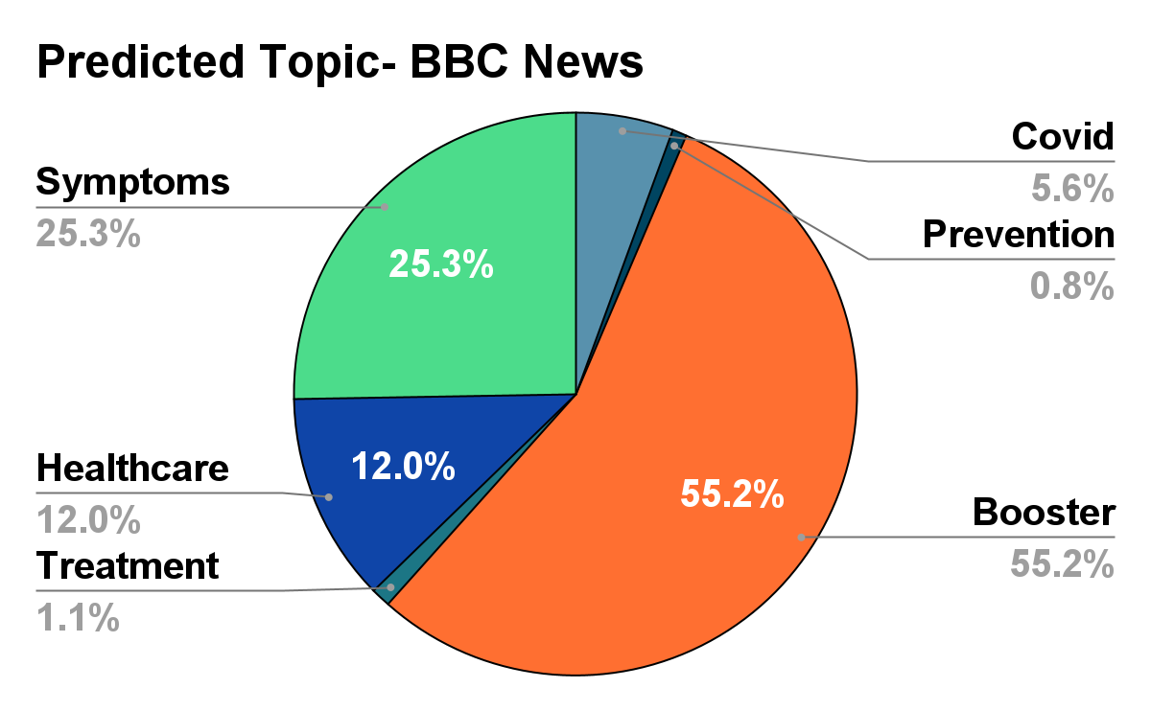
MOMENTUM AI: ZERO-SHOT CLASSIFICATION RESULTS

Slide 19
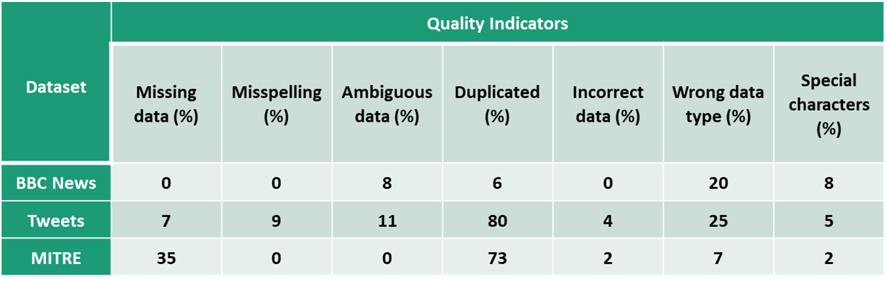
TEXT - COMMON DATA QUALITY ISSUES

Slide 20
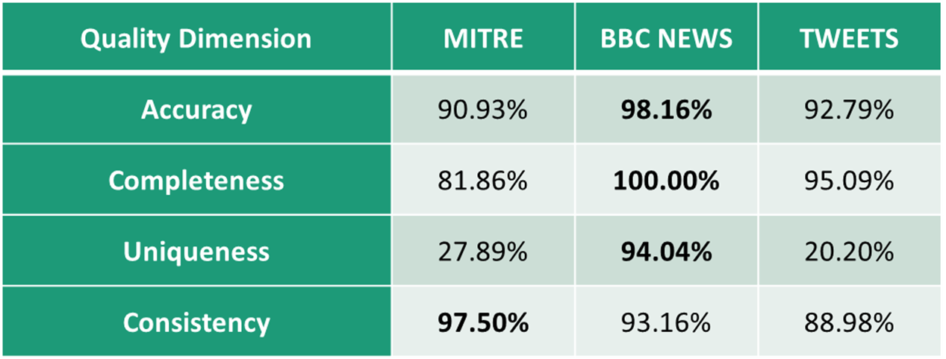
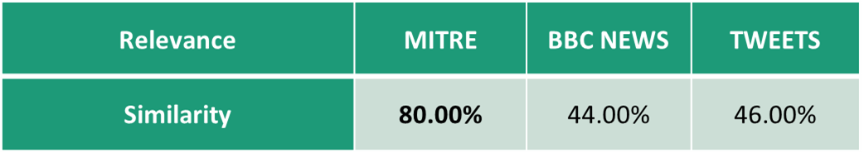
DATA QUALITY AND RELEVANCE METRICS

Slide 21
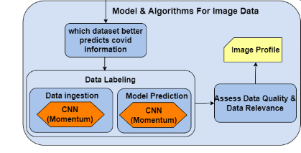

MOMENTUM AI- CONVOLUTIONAL NEURAL NETWORK
Covid
ML Classifier
Virus
Momentum AI
Data ingester
ML model(CNN)
Normal
ML Predictor
Pneumonia
Images
COVID PREDICTION

Slide 22
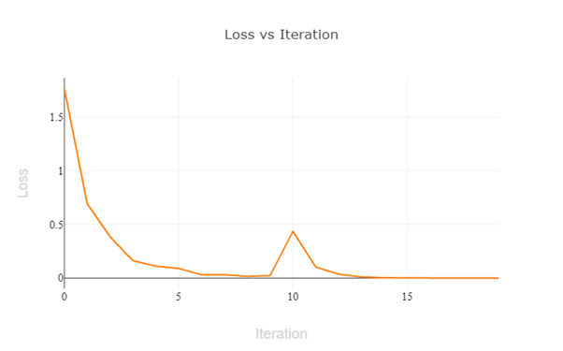
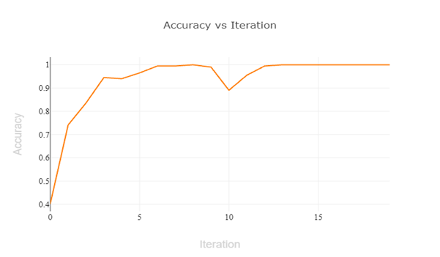
MODEL ACCURACY -COVID 19
Loss Function
Accuracy
We have acquired an accuracy of 93.75% and the loss is minimalized to its maximum.
Precision, Recall are 93.75%.
Loss function evaluates how well the algorithm models the dataset.
Lower the value, better the model.

Slide 23
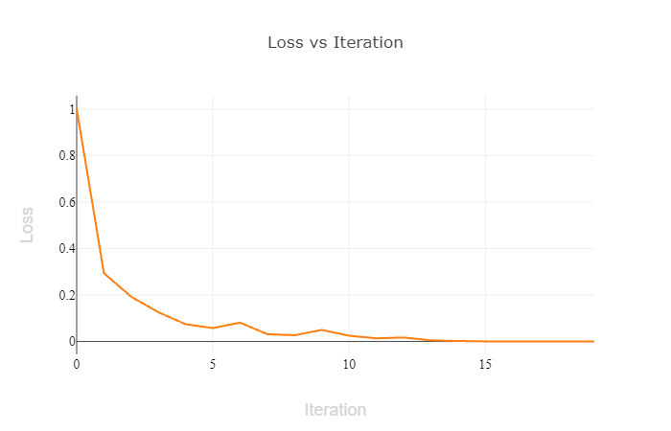
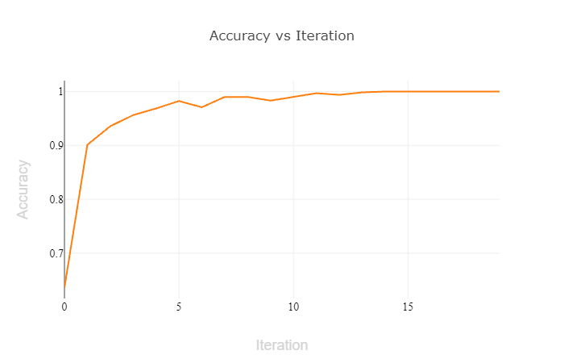
MODEL ACCURACY - COVID CXR
Loss Function
Accuracy
We have acquired an accuracy of 84.375% and the loss is minimalized to its maximum.
Precision & Recall are 84.375%.
Loss function evaluates how well the algorithm models the dataset.
Lower the value, better the model.

Slide 24
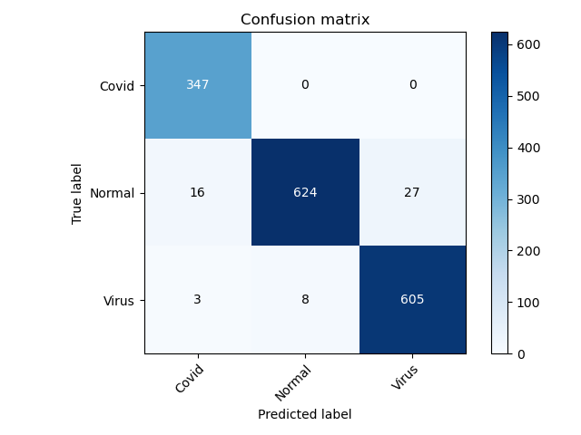
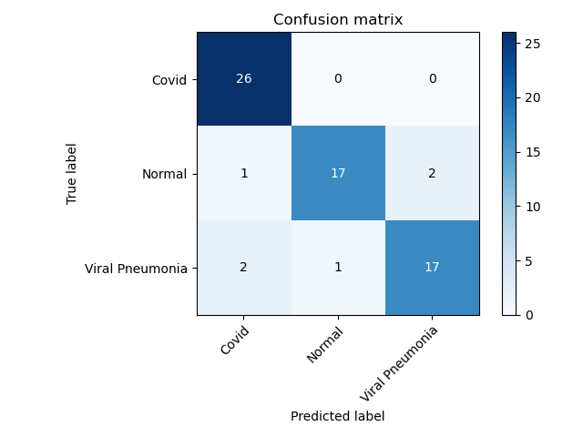
MOMENTUM- IMAGE DATASETS CLASSIFICATION RESULTS
COVID CXR Image dataset
Covid -19 Image dataset

Slide 25
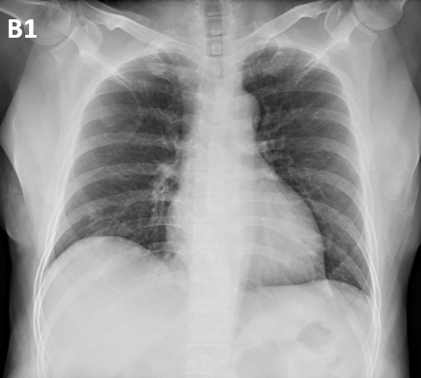
METADATA EXTRACTION
METADATA
DATA
Filename: Covid-19
Image Size:(500, 375)
Image height:500
Image Width:375
Image Format:JPEG
Image Mode:Grey scale
PILLOW

Slide 26
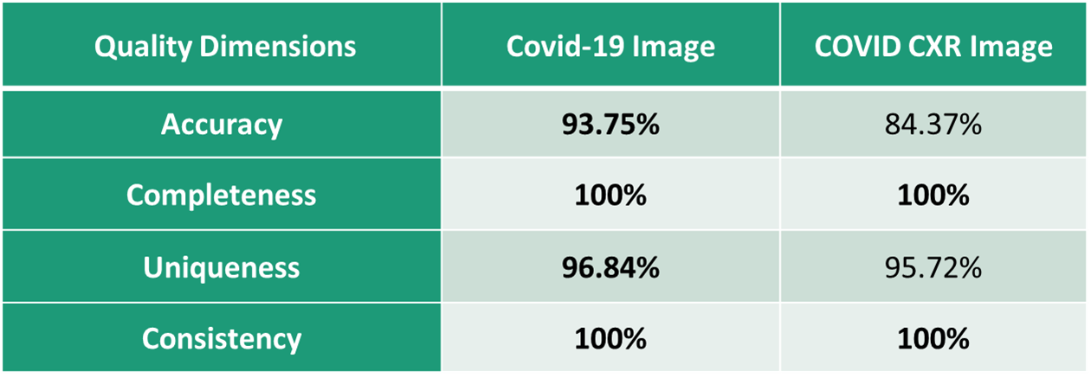

DATA QUALITY AND RELEVANCE METRICS

Slide 27
Results, Conclusion and Future Work
5

Slide 28
RESULTS
TEXT DATASETS
DATASET | BUSINESS QUESTION MAPPING | DATA QUALITY SCORE | RELEVANCE SCORE (Similarity Score) | FITNESS SCORE
MITRE SYNTHETIC HEALTH DATA | Most Relevant | 84.55% | 80% | 82.28%
BBC NEWS | Least Relevant | 96.34% | 44% | 69.83%
TWEETS | More Relevant | 79.27% | 46% | 62.64%
IMAGE DATASETS
DATASET | BUSINESS QUESTION MAPPING (Model Accuracy) | DATA QUALITY SCORE | RELEVANCE SCORE (F1-SCORE) | FITNESS SCORE
COVID -19 IMAGE | Most Relevant | 96.84% | 93.75% | 95.29%
COVID CXR | More Relevant | 95.72% | 84.37% | 90.04%

Slide 29
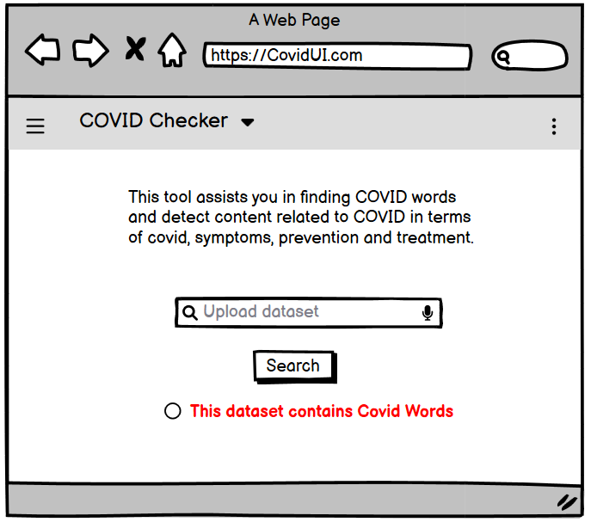
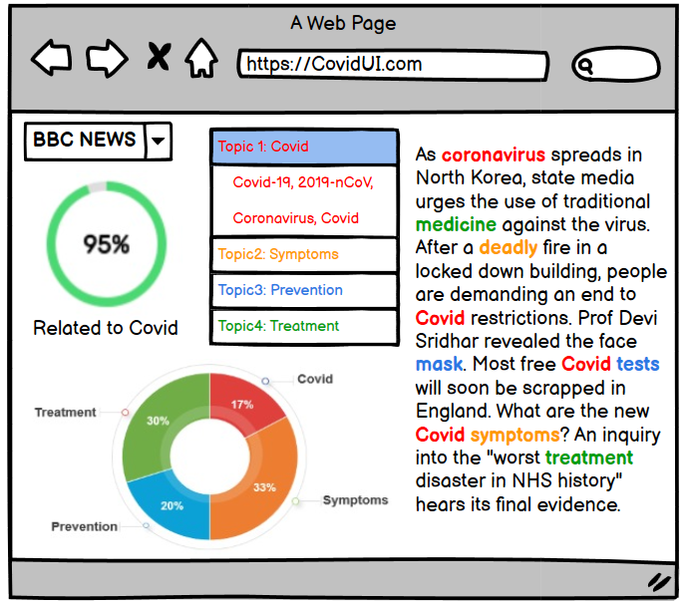
USER INTERFACE

Slide 30
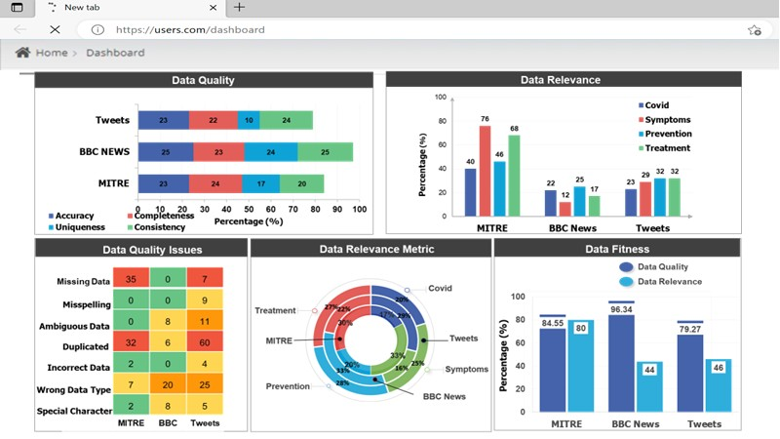
USER INTERFACE

Slide 31
FINDINGS
Text Dataset
Overall, for Business Question Mapping MITRE Synthetic Health Data dataset provide most information.
In case of data fitness MITRE Synthetic Health data is best fit too.
Users will be able to easily differentiate datasets that best address their business questions and tasks, and assess data resources for fitness.
Automated Data Tagging using Topic modeling (Covid topics tagging).
Automating data tagging will reduce the time and costs.
Image Dataset
Overall, for our Business Question Mapping Covid-19 Image dataset provides most information.
In case of data fitness Covid-19 Image dataset is best fit too.
Identify covid cases with help of machine learning by processing the images of chest X-rays.

Slide 32



NEXT STEPS
Identify and detect texts from any domain from articles or videos.
Populate both text and image data catalog using tools (eg: Alation).
Researchers can integrate EHR data with the COVID-19 image dataset to develop more comprehensive models for predicting COVID-19.

Slide 33

THANK YOU

